Slide 1
EPR Projectathon 2022 Pre-Testing Opening
Pre-TEST webinar 01/07/2022
Souleymane THIAM IHE-Catalyst

Slide 2
Agenda
Projectathon milestones and calendar
Projectathon Testing Process
Projectathon phase
Pre-testing Phase
The Gazelle platform (EVSClient et TM)
Additional information

Slide 3
Projectathon milestones and calendar
June
July
August
September
Registration
from Marsh 1st to July 1st
Pre-projectathon tests
from July 1st to Sept 9th
PAT
Sept 12-16
Pre- Testing
01/07
Report publication
30/09

Slide 4
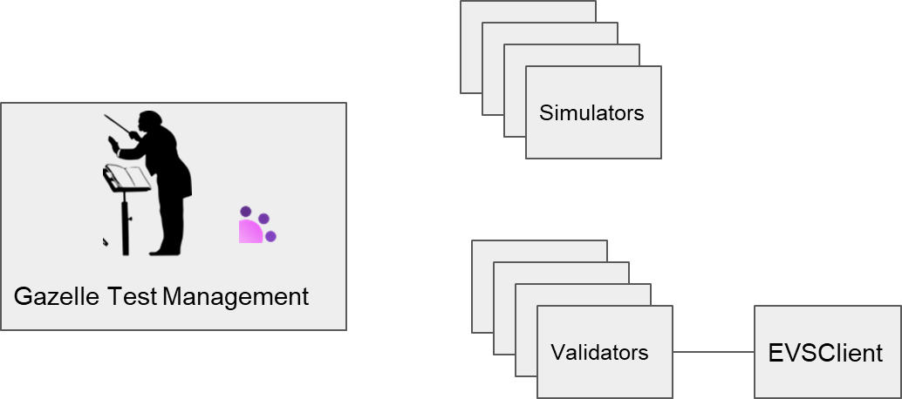
Projectathon Testing Process
Main platform
EPR Gazelle test platform https://ehealthsuisse.ihe-europe.net

Slide 5
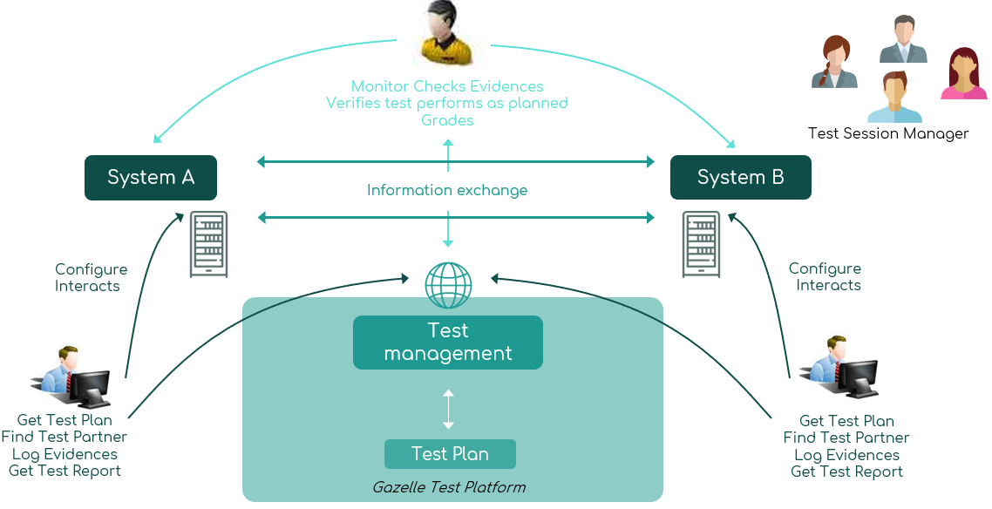
Projectathon phase

Slide 6
Pre-testing Phase
2. Run transaction and exchange messages with simulators
System under test
Simulators
1. Read test plan and test description
SUT operator
3. Validate exchanged messages with
Gazelle Test Management
EVSClient
4. Collect all test evidences in Test Management
EVSClient
Validators

Slide 7
EPR Projectathon – Testability
Profiles to test | Testable during pre-PAT tests | Testable during PAT
MHD | NIST FHIR Toolkit | EVSClient
XDS | XDStarClient XDSToolkit | EVSClient
IUA | NO | Yes with a new validator
PDQv3 | Patient Manager | EVSClient
PPQm | NO | EVSClient
PIXv3 | Patient Manager | EVSClient
PIXm | Patient Registry (only ITI83) | EVSClient (all transactions)
XDM | NA | NA
ATNA | Gazelle Security Suite | EVSClient Gazelle Security Suite
RESTful ATNA | ? | ?
CT | NA | NA

Slide 8
EPR Projectathon – Testability
Profiles to test | Testable during pre-PAT tests | Testable during PAT
HPD | HPD Simulator EVSClient | EVSClient Proxy
RMU | GWT XDSTools | EVSClient
SVS | SVS Simulator | EVSClient
XCA | GWT XDSTools | EVSClient
XCPD | Patient Manager | EVSClient
XUA | GWT | EVSClient

Slide 9
EPR Projectathon – Testability
Profiles to test | Testable during pre-PAT tests | Testable during PAT
ADR | GWT (Client) ADR Simulator (Server) | EVSClient
ATC | ATC Patient ARR (Server) GWT (Client) | EVSClient
CPI | HPD Simulator | EVSClient
UPI | UPI Simulator | EVSClient
PPQ | PPQ simulator (Server) GWT (Client) | EVSClient
Exchange Formats Profiles | NO Simulator Yes Validator | EVSClient

Slide 10
Pre-testing Phase
Prerequisite
System registration and acceptance
If you have sent your contract, to IHE Services, your system has been accepted in Gazelle, which allows you to see the test plan in the “CAT” page
Declare your system configuration
Hosts and OIDs
Ports and usage
Validate your configuration (this allows other participants to see it)
Update your certificates (if necessary)
Request a certificate in GSS PKI:
https://ehealthsuisse.ihe-europe.net/gss/request/withoutcsr.seam
Add the CA to your truststore
https://ehealthsuisse.ihe-europe.net/gss/certificate/view.seam?id=22

Slide 11
Pre-testing Phase
Pre-testing
Go to Connectathon>Pre-connectathon>Pre-connectathon
Testing
Your systems registered for the event will be listed here
Click on the number of tests to complete
All the pre-tests for the actors you registered are listed
Open the test description by clicking on the globe
Perform your test
Upload your proofs to the previous page by clicking on the
“Return log file(s)” button
Once everything is done, change the test status to “verified by vendor”.

Slide 12
The Gazelle platform – Gazelle Test Management
Gazelle Test Management
Central tool to the organization of the Projectathon
Give access to test plan, test instance management, systems and participants registration…

Slide 13
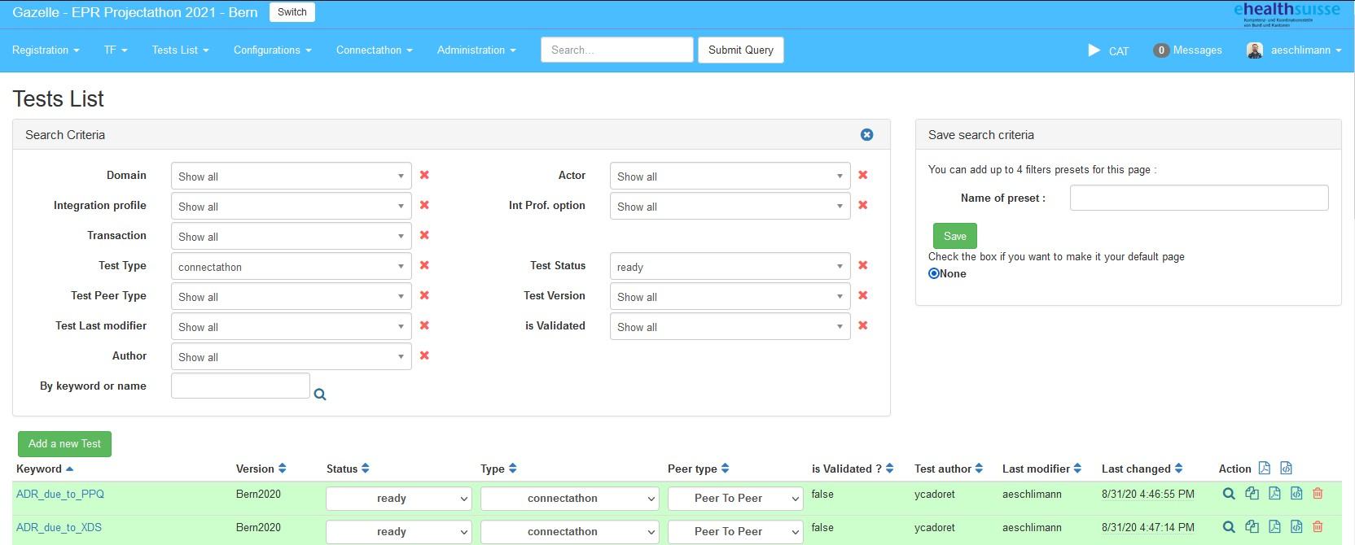
The Gazelle platform – Gazelle Test Management
Access the test plan in the menu Test list > Test Definition
Filter to see preparatory tests (type : pre-connectathon) and Projectathon tests (type : connectathon)

Slide 14
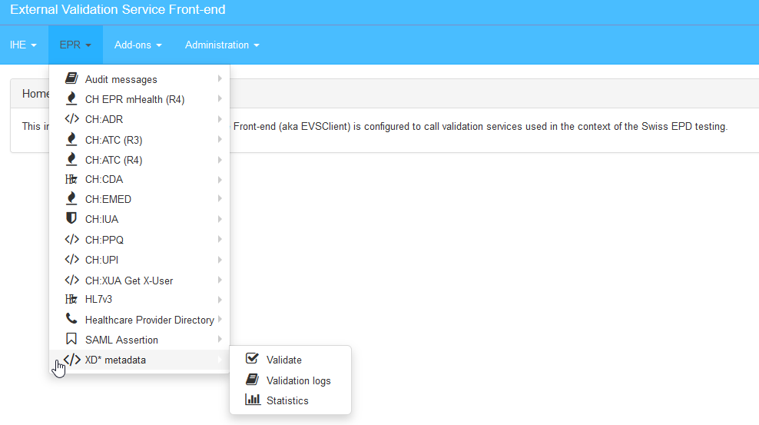
The Gazelle platform – EVS Client
EVS Client is a tool allowing the syntactic validation of messages sent by your system.
and semantic

Slide 15
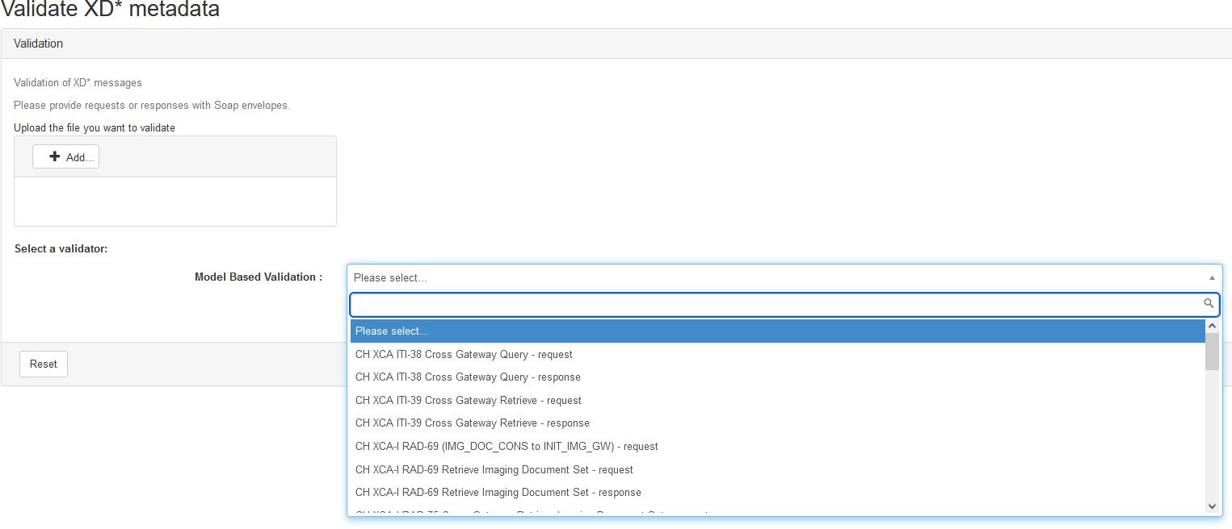
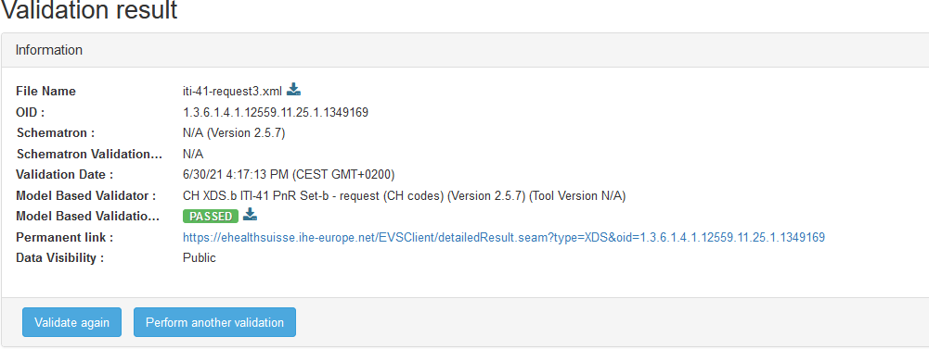
The Gazelle platform – EVS Client
Copyright © 2020

Slide 16
Additional information - Communication
Rocket.Chat (open source tool)
Will be made available in July (participants registered for the event will
receive an account creation email)
https://testing.chat.ihe-europe.net/
Communication by channels, messages…
private
groups,
direct
Video calls by Jitsi

Slide 17
Demonstration Pre-Testing

Slide 18
Q&A Session

